Slide 1
Recognizing and Classifying Objects
For lab5, we can use RANSAC function from openCV.
CSCI 4150/6050: Computer Vision
Many of the slides are from
Professor Kristen Grauman (UT-Austin), Ryan Farrell (BYU), and David Wingate

Slide 2
What is the difference between recognition and classification?

Slide 3


Classification
This is a cat!
AARON AMAT/SHUTTERSTOCK

Slide 4
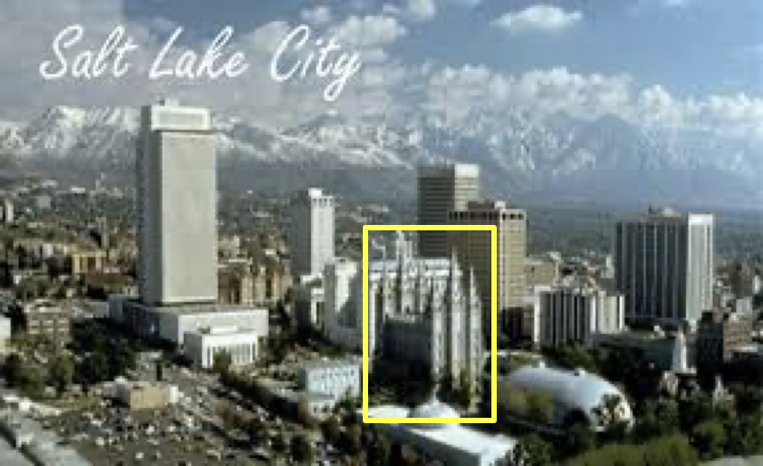
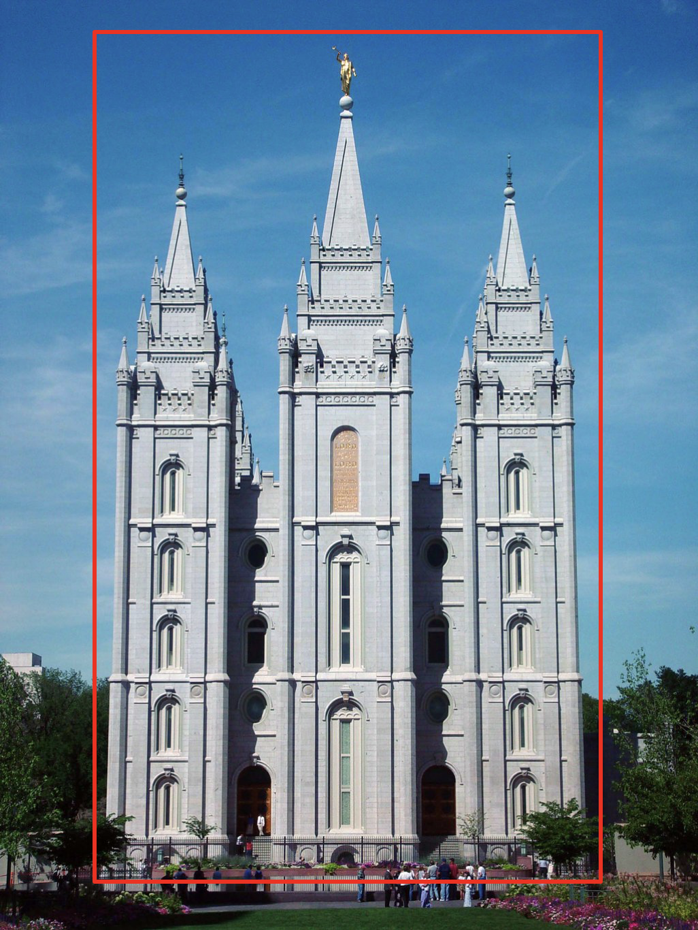
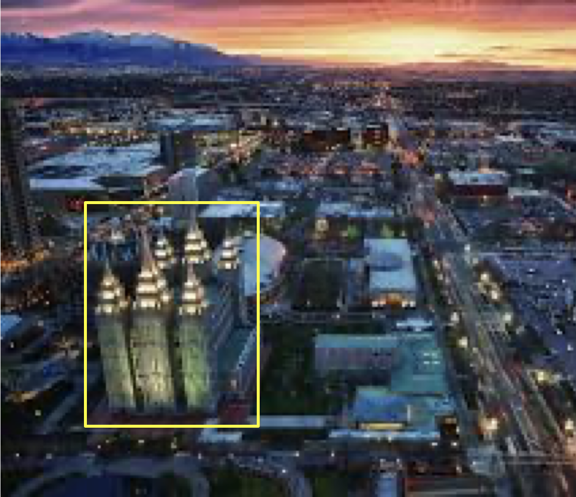
Recognition
This is that same building
I have seen before.

Slide 5
Both classification and recognition can be addressed using similar techniques. We will discuss those techniques in this lesson.

Slide 6
Indexing local features
Main idea: Parts of images hsould be able to be described with a set of numbers in such a way that similar parts of those images should land on similar spots in the despcriptors feature space.
Each patch / region has a descriptor, which is a point in some high-dimensional feature space (e.g., SIFT)
Descriptor’s feature space

Slide 7
Indexing local features
When we see close points in feature space, we have similar descriptors, which indicates similar local content
Descriptor’s feature space
Query image
Database images
Easily can have millions of features to search!

Slide 8

Analogy to documents
Of all the sensory impressions proceeding to the brain, the visual experiences are the dominant ones. Our perception of the world around us is based essentially on the messages that reach the brain from our eyes. For a long time it was thought that the retinal image was transmitted point by point to visual centers in the brain; the cerebral cortex was a movie screen, so to speak, upon which the image in the eye was projected. Through the discoveries of Hubel and Wiesel we now know that behind the origin of the visual perception in the brain there is a considerably more complicated course of events. By following the visual impulses along their path to the various cell layers of the optical cortex, Hubel and Wiesel have been able to demonstrate that the message about the image falling on the retina undergoes a step-wise analysis in a system of nerve cells stored in columns. In this system each cell has its specific function and is responsible for a specific detail in the pattern of the retinal image.
China is forecasting a trade surplus of $90bn (£51bn) to $100bn this year, a threefold increase on 2004's $32bn. The Commerce Ministry said the surplus would be created by a predicted 30% jump in exports to $750bn, compared with a 18% rise in imports to $660bn. The figures are likely to further annoy the US, which has long argued that China's exports are unfairly helped by a deliberately undervalued yuan. Beijing agrees the surplus is too high, but says the yuan is only one factor. Bank of China governor Zhou Xiaochuan said the country also needed to do more to boost domestic demand so more goods stayed within the country. China increased the value of the yuan against the dollar by 2.1% in July and permitted it to trade within a narrow band, but the US wants the yuan to be allowed to trade freely. However, Beijing has made it clear that it will take its time and tread carefully before allowing the yuan to rise further in value.
sensory, brain,
visual, perception,
retinal, cerebral cortex,
eye, cell, optical
nerve, image
Hubel, Wiesel
China, trade,
surplus, commerce,
exports, imports, US,
yuan, bank, domestic,
foreign, increase,
trade, value
ICCV 2005 short course, L. Fei-Fei

Slide 9

Visual words: main idea
e.g., SIFT descriptor space: each point is 128-dimensional
Extract some local features from a number of images …
Slide credit: D. Nister, CVPR 2006

Slide 10
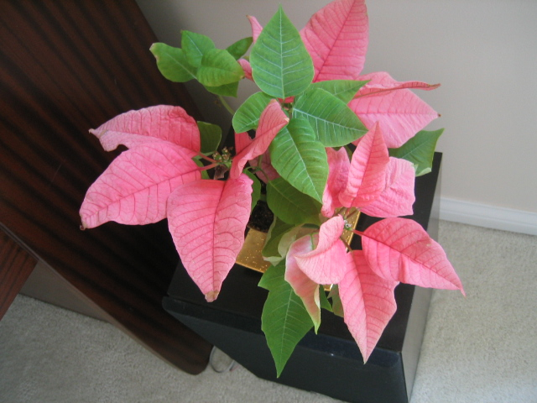
Visual words: main idea

Slide 11
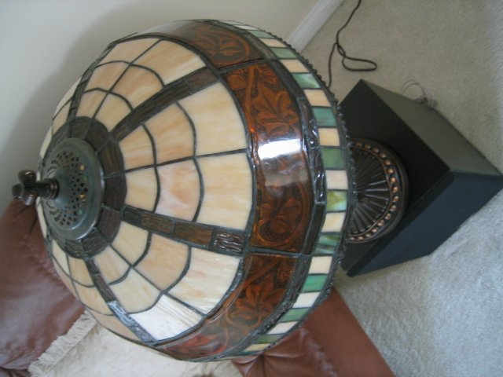
Visual words: main idea

Slide 12

Visual words: main idea

Slide 13
Each point is a local descriptor, e.g. SIFT vector.

Slide 14
Eg k means clustering to represent these clusters seperately in the feature space.
Ie sift descriptors are close to each other so represent them as one type of word.

Slide 15
Visual words
Map high-dimensional descriptors to tokens/words by quantizing the feature space
Quantize via clustering, let cluster centers be the prototype “words”
Word #2
Determine which word to assign to each new image region by finding the closest cluster center
Descriptor’s feature space

Slide 16
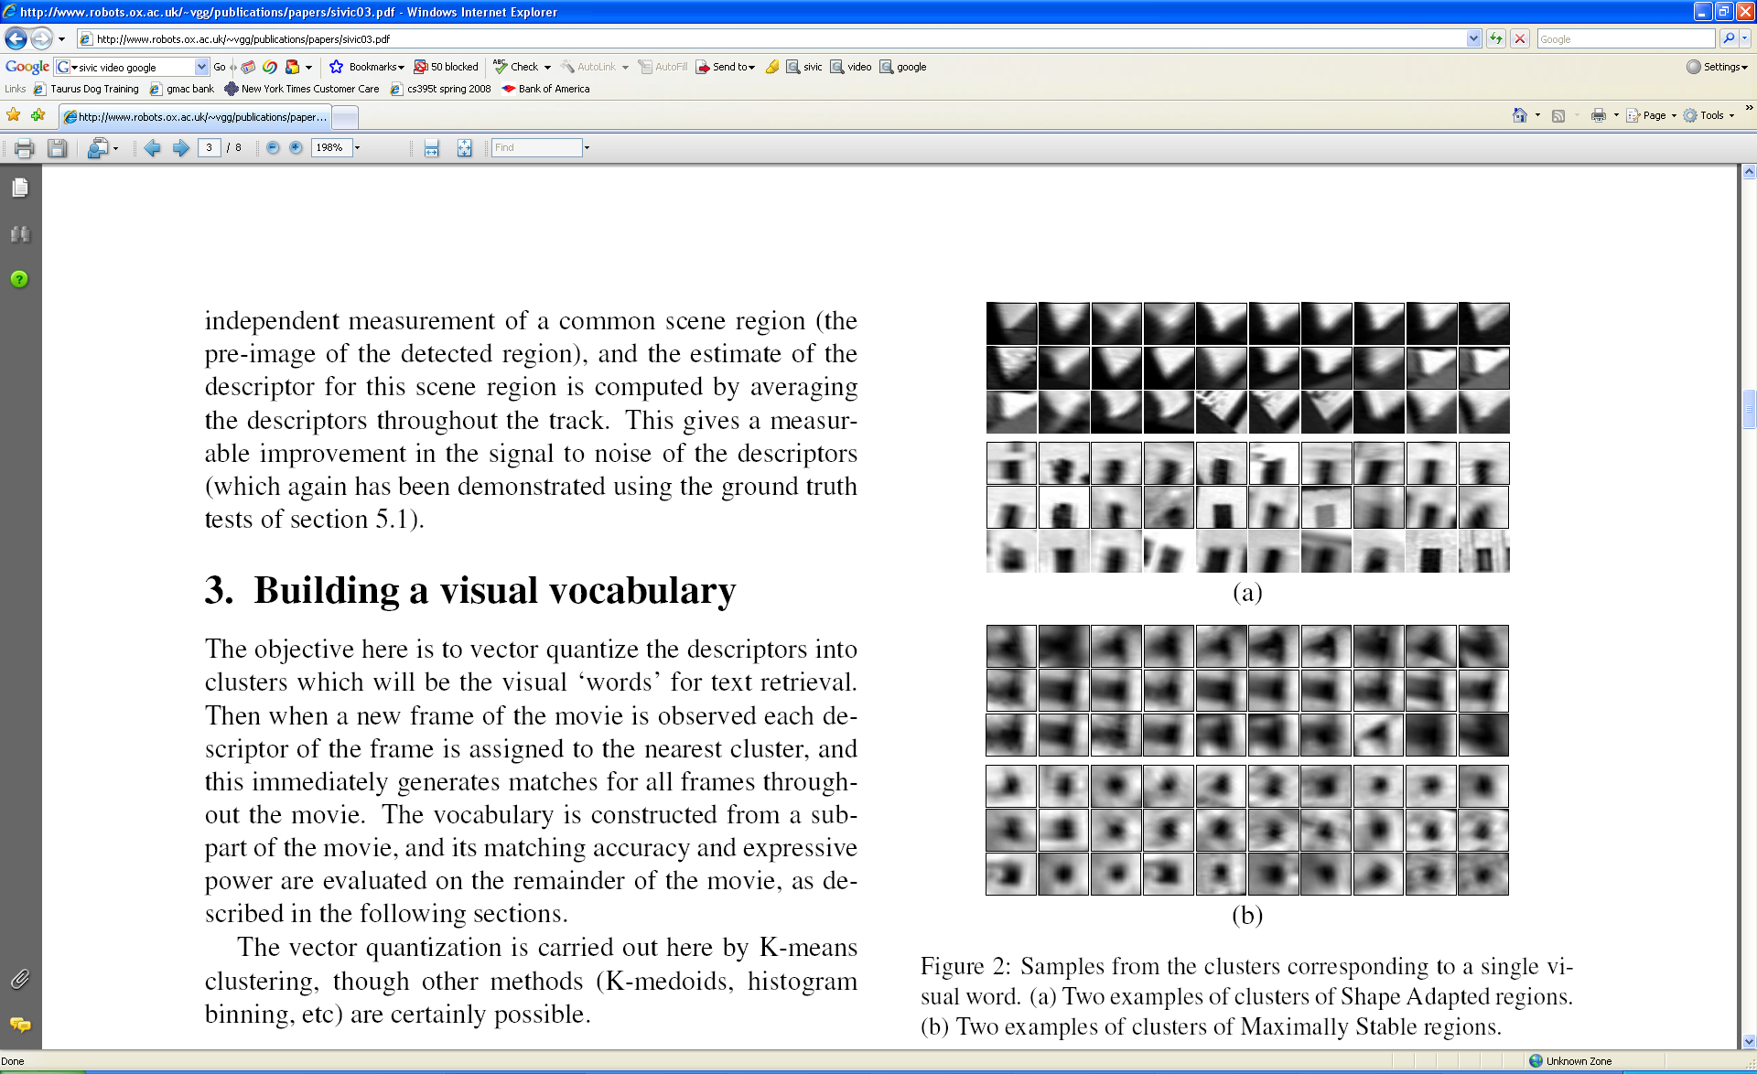
Visual words
Example: each group of patches belongs to the same visual word
Figure from Sivic & Zisserman, ICCV 2003

Slide 17
Visual vocabulary formation
Issues:
  Vocabulary size, number of words, too small everything looks similar, too big everything looks different.
  Sampling strategy: where to extract features?
  Clustering / quantization algorithm
  Unsupervised vs. supervised
  What corpus provides features (universal vocabulary?)

Slide 18
Analogy to documents
Ie using the words given, guess the book or paper.
Of all the sensory impressions proceeding to the brain, the visual experiences are the dominant ones. Our perception of the world around us is based essentially on the messages that reach the brain from our eyes. For a long time it was thought that the retinal image was transmitted point by point to visual centers in the brain; the cerebral cortex was a movie screen, so to speak, upon which the image in the eye was projected. Through the discoveries of Hubel and Wiesel we now know that behind the origin of the visual perception in the brain there is a considerably more complicated course of events. By following the visual impulses along their path to the various cell layers of the optical cortex, Hubel and Wiesel have been able to demonstrate that the message about the image falling on the retina undergoes a step-wise analysis in a system of nerve cells stored in columns. In this system each cell has its specific function and is responsible for a specific detail in the pattern of the retinal image.
China is forecasting a trade surplus of $90bn (£51bn) to $100bn this year, a threefold increase on 2004's $32bn. The Commerce Ministry said the surplus would be created by a predicted 30% jump in exports to $750bn, compared with a 18% rise in imports to $660bn. The figures are likely to further annoy the US, which has long argued that China's exports are unfairly helped by a deliberately undervalued yuan. Beijing agrees the surplus is too high, but says the yuan is only one factor. Bank of China governor Zhou Xiaochuan said the country also needed to do more to boost domestic demand so more goods stayed within the country. China increased the value of the yuan against the dollar by 2.1% in July and permitted it to trade within a narrow band, but the US wants the yuan to be allowed to trade freely. However, Beijing has made it clear that it will take its time and tread carefully before allowing the yuan to rise further in value.
sensory, brain,
visual, perception,
retinal, cerebral cortex,
eye, cell, optical
nerve, image
Hubel, Wiesel
China, trade,
surplus, commerce,
exports, imports, US,
yuan, bank, domestic,
foreign, increase,
trade, value
ICCV 2005 short course, L. Fei-Fei

Slide 19
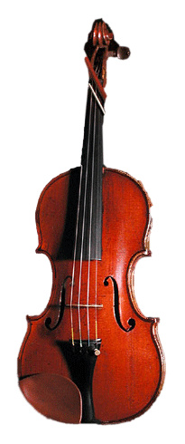
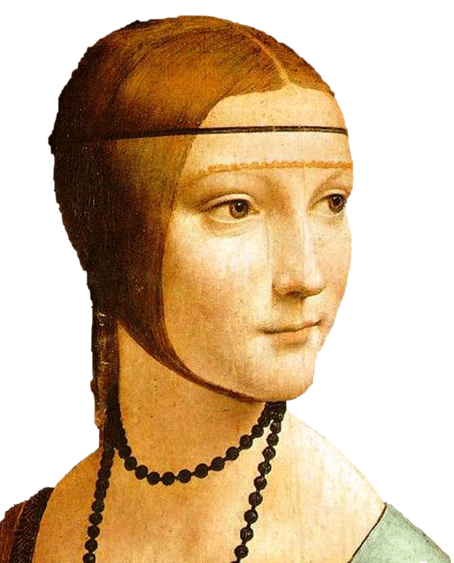
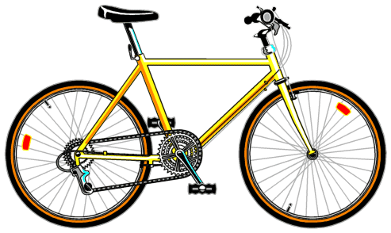
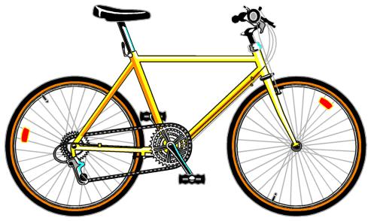
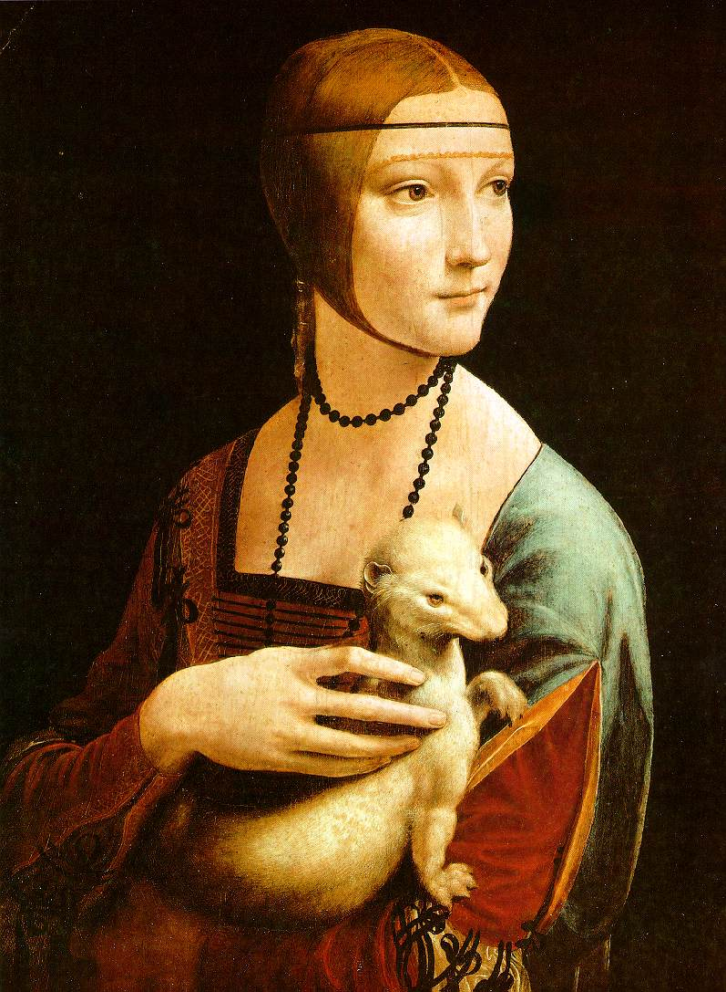

Slide 20
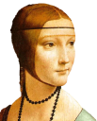






Bags of visual words
Summarize entire image based on its distribution (histogram) of word occurrences.
Analogous to bag of words representation commonly used for documents.

Slide 21
Detour: Comparing Vectors
L1 Norm (Manhattan Distance)
L2 Norm (Euclidean Distance)
L∞ Norm (Chebyshev Distance)
Cosine Similarity (Angle)
many others…

Slide 22
Detour: Comparing Vectors
L1 Norm (Manhattan Distance)
L2 Norm (Euclidean Distance)
L∞ Norm (Chebyshev Distance)
Cosine Similarity (Angle)
$L_{1}\left(v_{1},v_{2}\right)=\sum{v_{2}−v_{1}∨}$
$L_{2}\left(v_{1},v_{2}\right)=\sqrt{\sum{v_{2}−v_{1}∨{}^{2}}}$
$L_{∞}\left(v_{1},v_{2}\right)=max⁡\left(\left|v_{2}−v_{1}\right|\right)$
$sim\left(v_{1},v_{2}\right)=\frac{v_{1}∙v_{2}}{\left\|v_{1}\right\|\left\|v_{2}\right\|}$

Slide 23
Detour: Comparing Vectors
L1 Norm (Manhattan Distance)
L2 Norm (Euclidean Distance)
L∞ Norm (Chebyshev Distance)
Cosine Similarity (Angle)
L1(v1,v2) = np.sum(np.abs(v2-v1))
L2(v1,v2) = np.sqrt(np.sum((v2-v1)**2))
L_inf(v1,v2) = np.max(np.abs(v2-v1))
cos_sim(v1,v2) =
np.sum(v1*v2)
np.linalg.norm(v1)*np.linalg.norm(v2)

Slide 24
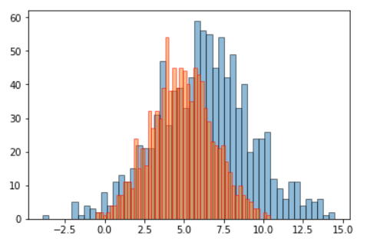
Detour: Comparing Distributions
If there are only have positive values in the vector, then it can be treated as a probability distribution and the following additional metrics can be used:
Wasserstein Distance (Earth Mover)
  If the distributions were piles of dirt, how much dirt would you have to move to make one distribution look like the other?
Kullback–Leibler divergence
many others…
https://stats.stackexchange.com/questions/339313/comparing-distributions-bayesian-decision-analysis

Slide 25
Bags of visual words
Summarize entire image based on its distribution (histogram) of word occurrences.
Analogous to bag of words representation commonly used for documents.

Slide 26





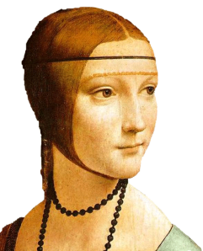
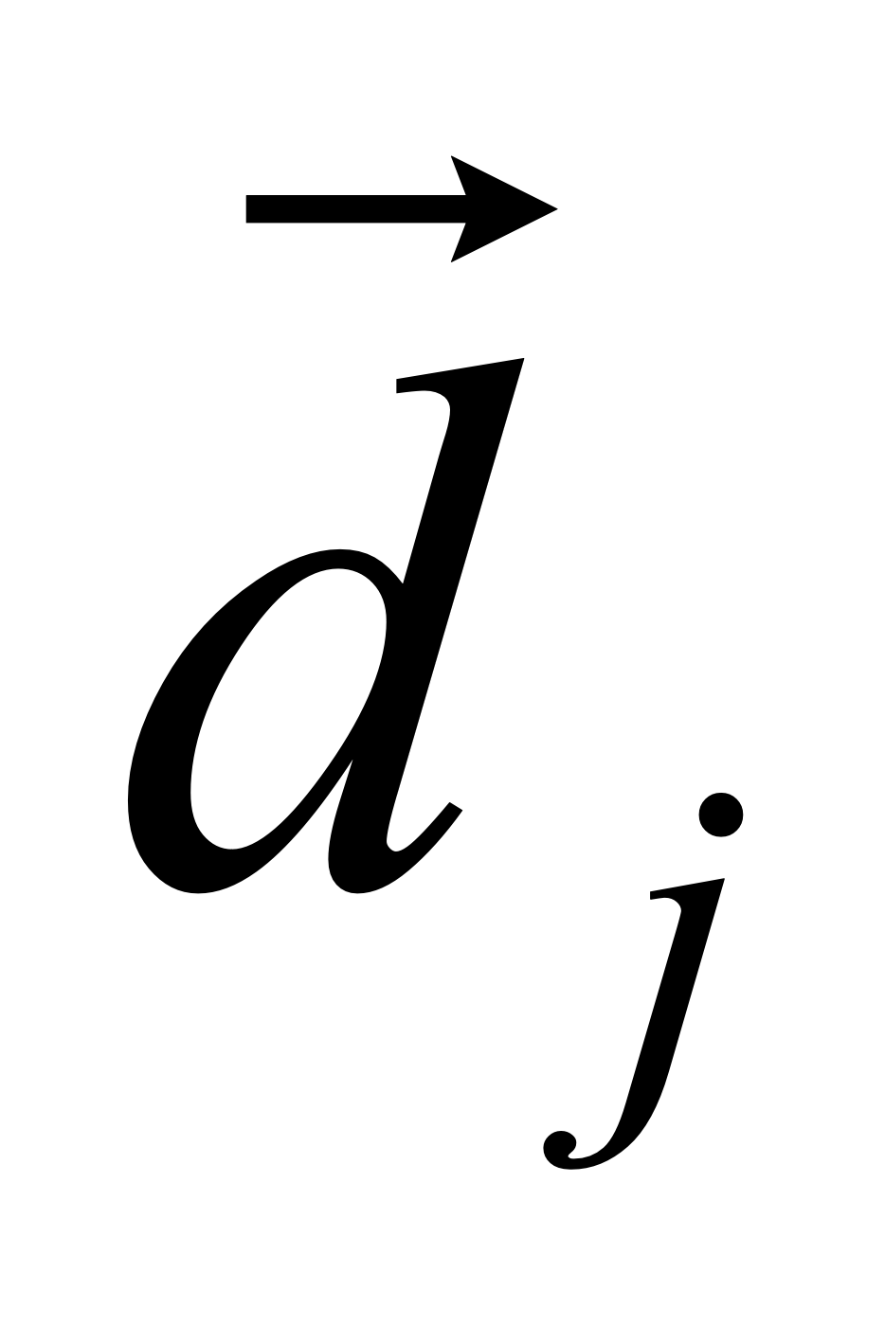

Comparing bags of words
Rank frames by normalized scalar product between their occurrence counts (cosine similarity) ---nearest neighbor search for similar images.
[1 8 1 4]
[5 1 1 0]
$sim\left(d_{j},q\right)=\frac{\left\langle d_{j},q\right\rangle }{\left\|d_{j}\right\|\left\|q\right\|}$
$\frac{\sum_{i=1}^{V}{d_{j}\left(i\right)∗q\left(i\right)}}{\sqrt{\sum_{i=1}^{V}{{d_{j}\left(i\right)}^{2}}}∗\sqrt{\sum_{i=1}^{V}{{q\left(i\right)}^{2}}}}$
for vocabulary of V words

Slide 27
Instance Recognition: remaining issues
How to summarize the content of an entire image?
And gauge overall similarity?
How large should the vocabulary be?
How to perform quantization efficiently?
Is having the same set of visual words enough to identify the object/scene?
How to verify spatial agreement?
How to score the retrieval results?
Ie a human has two eyes above the nose but an image of a face with an eye on the jaws may still be considered a
Human eye or face.

Slide 28
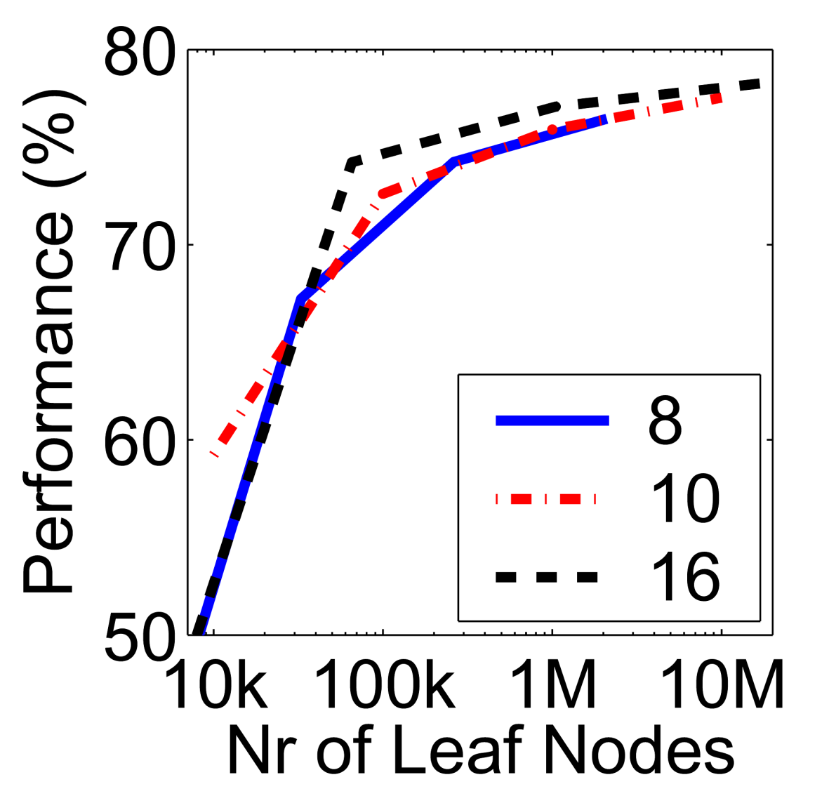
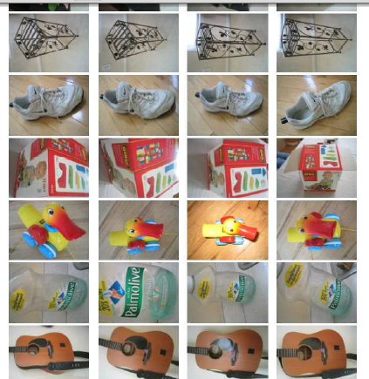
Vocabulary size
Results for recognition task with 6347 images
Branching factors
Influence on performance, sparsity
Nister & Stewenius, CVPR 2006

Slide 29
Visual words/bags of words
+ flexible to geometry / deformations / viewpoint
+ compact summary of image content
+ provides vector representation for sets
+ very good results in practice, though not really used anymore, ie till like 2012, now we use deep learning?
background and foreground mixed when bag covers whole image
optimal vocabulary formation remains unclear
basic model ignores geometry – must verify afterwards, or encode via features

Slide 30
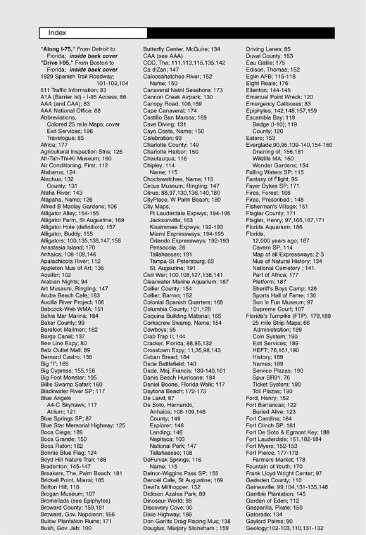
Indexing local features: inverted file index
For text documents, an efficient way to find all pages on which a word occurs is to use an index…
We want to find all images in which a feature occurs.
We can use the same approach with our “visual words”.

Slide 31
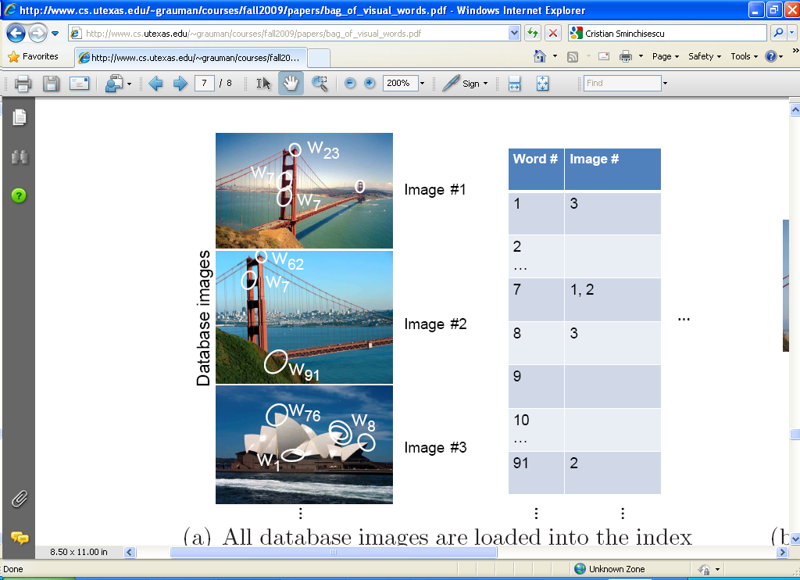
Inverted file index
Database images are loaded into the index mapping words to image numbers

Slide 32
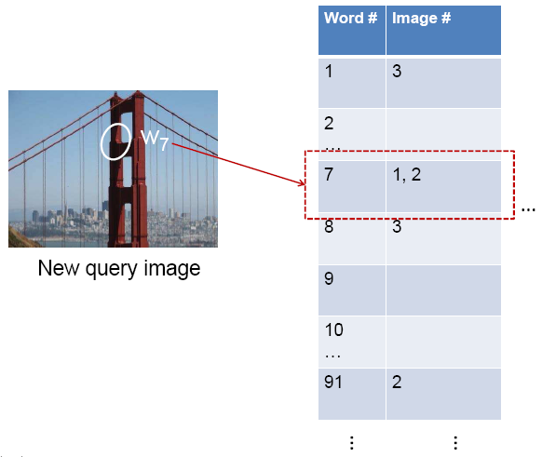
Inverted file index
New query image is mapped to indices of database images that share a word.

Slide 33
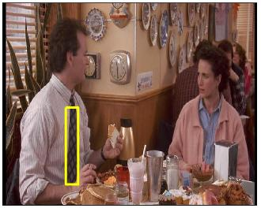
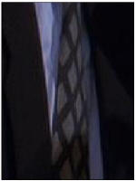
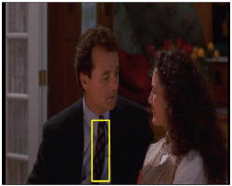
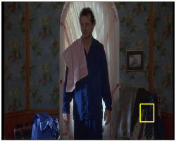
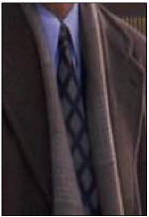
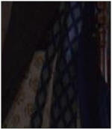
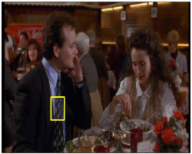
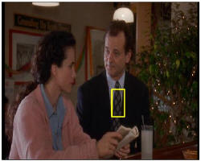
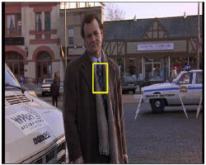
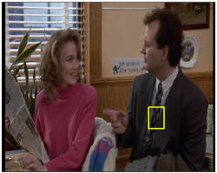
Video Google System
Query region
Collect all words within query region
Inverted file index to find relevant frames
Compare word counts
Spatial verification
Sivic & Zisserman, ICCV 2003
Retrieved frames

Slide 34
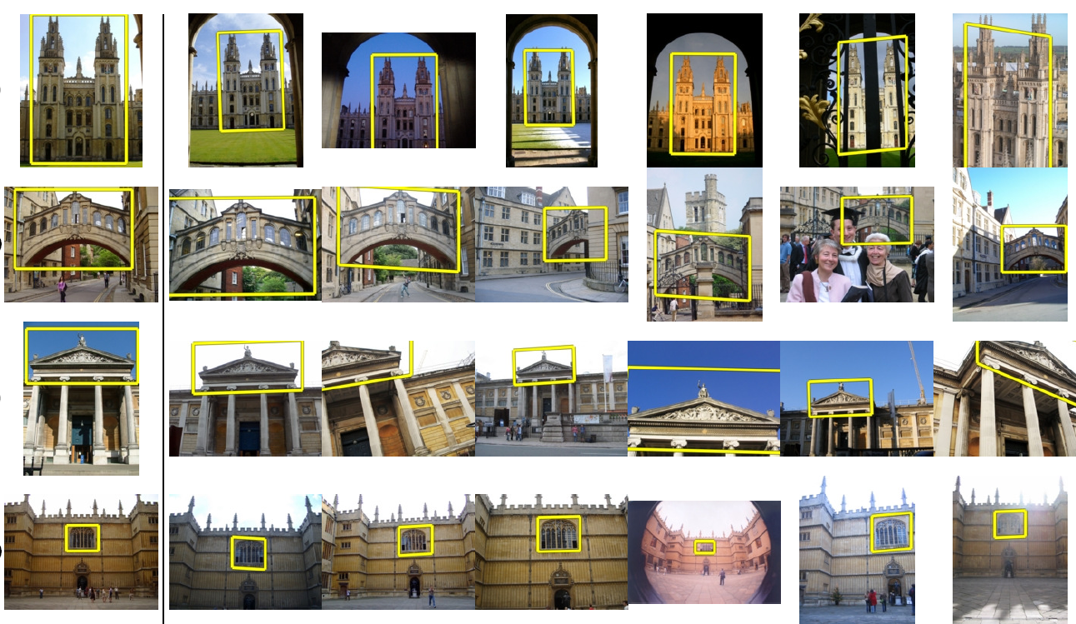
Application: Large-Scale Retrieval
Query
Results from 5k Flickr images (demo available for 100k set)
[Philbin CVPR’07]

Slide 35
Summary of Classical Techniques
Matching local invariant features
  Useful not only to provide matches for multi-view geometry, but also to find objects and scenes.
Bag of words representation: quantize feature space to make discrete set of visual words
  Summarize image by distribution of words
  Index individual words
  Works for both recognition and classification
Inverted index: pre-compute index to enable faster search at query time

Slide 36
…but can we do better?

Slide 37
ImageNet Accuracy (around 2013)
Deep learning started in 2012 with this imagenet database that had a large number of images and label. Others used previously discussed accuracy of classification of like 50%.
AlexNet introduced a new method, used convolutional neural network and improved the accuracy to like 80%
What they did differently is with classical methods, we use sift to describe our own features but they used the deep learning methods to determine these features.

Slide 38
Welcome to the AI revolution!

Slide 39

Artificial Intelligence
Yes, Yes, Yes

Slide 40
Difficulties in Classification
How do you craft useful features of an image?
How do you know if features are part of your object or are in the background?
How do you separate the feature space?
KEY IDEA: What if we let a machine learning algorithm decide all these things at the same time?

Slide 41
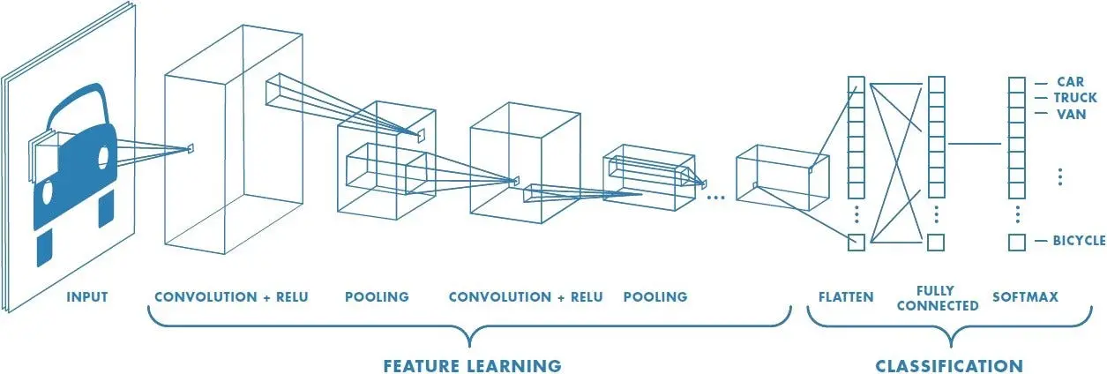
Convolutional Neural Networks (CNN)
Use standard convolution as your feature extractor, but let the neural networks learn the weights.
Learn the classification targets at the same time you learn the weights.
Image Credit: Sumit Saha

Slide 43




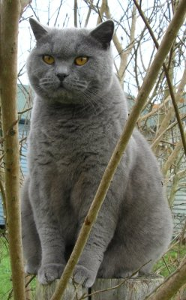

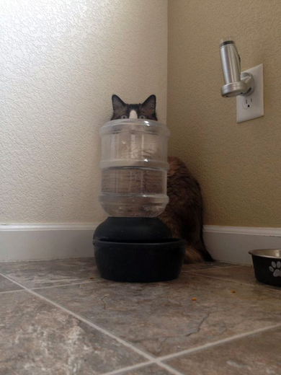
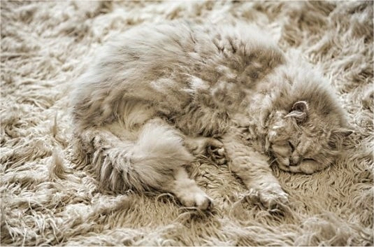

Big Picture
Supervised Learning Pipeline
1. Labeled data,
2. time 1:39, thurs oct 15, screenshot.

Slide 45
Train/Test

Slide 46
Train/Test
Cat
Results

Slide 47
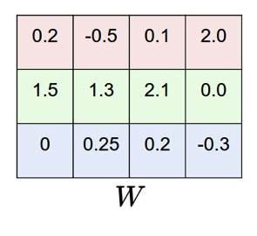
Save
Train/Test

Slide 48
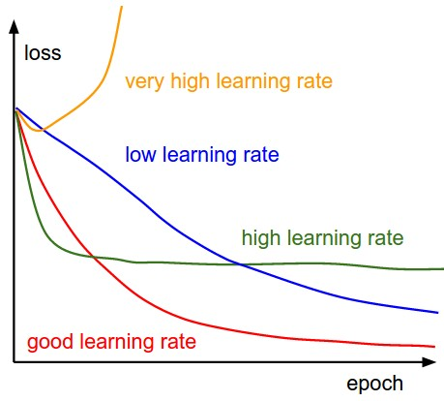
Train/Test
Visualize

Slide 49
Save
Train/Test
Cat
Results
Visualize

Slide 50
Training

Slide 51

Training
0.55
-1.24
Score
Loss
Forward

Slide 52
Training
0.55
-1.24
Score
Loss
Backward

Slide 53
Optimize
Training
Score
Loss

Slide 54
Optimize
Training
Score
Loss

Slide 55
Optimize
Training
Score
Loss

Slide 56
Testing
Score
Loss
Forward

Slide 57
Coming Up…
CNN Design

